Slide 1

Devolution of Services and Assets
Rother District Council

Slide 2

Overview
Sustaining Local Services: a shared challenge
What is the Services and Assets Devolution Framework?
Why now?
Limitations on what can be devolved
Notes:
How presentation will benefit audience: Adult learners are more interested in a subject if they know how or why it is important to them.
Presenter’s level of expertise in the subject: Briefly state your credentials in this area, or explain why participants should listen to you.

Slide 3
Sustaining Local Services: a shared challenge
The Council is mindful that the loss of services is a difficult message for residents
The reasons for the cuts to local government in recent years are complex
Ultimately, residents may need to pay more if they want to sustain some local services
The Council is keen to work with communities to maximise opportunities to sustain local services
However, there are shared limitations and constraints on us all and it is important to recognise these.

Slide 4
What is the Services and Assets Devolution Framework?
The Framework provides the criteria against which the Council may devolve some local services and assets to parish and town councils and eligible community groups
The purpose of the Framework is to protect valued local services and assets that are at risk of being cut
Any party interested in having assets or services devolved must be familiar with the terms of the Framework

Slide 5
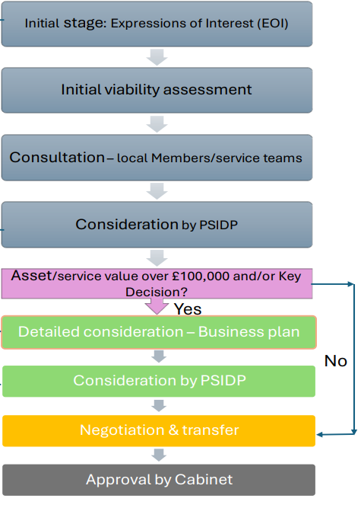
Framework for Devolution – Flowchart
RDC Assessment includes:
Commercial opportunity
Bio-diversity value
Community value
“Red Book” or open market value
Legal constraint / ability to demonstrate best value in order to Devolve

Slide 6
Why Now?
Local Government Reorganisation will mean a new ‘unitary authority’ will replace Rother Council by March 2028
If services and assets are not devolved, they will transfer to the new unitary authority – risk services are reduced or assets are sold
The Council is mindful that the cost of these services will be challenging for many residents to afford

Slide 7
Limitations
Local Government Act 1972 – the Council cannot readily devolve assets that generate significant income or hold a significant financial value
Resources – the Council has limited resources and cannot guarantee that all assets identified can be devolved within LGR timeframes
Time – the devolution process takes time and there may be a lot of background work to complete. Note that a new Shadow Authority could veto disposals from December 2026.

Slide 8
Limitations
Some assets will not be eligible for devolution. This may include:
Assets that generate significant income or are held to fulfil strategic priorities
Assets held for future capital realisation
Assets or land held for future development of a Council or partner scheme
Vacant land or buildings that can generate a significant capital receipt

Slide 9
Any questions?

