Slide 1
Rother District Council and Developers East Sussex Welcome to the Housing Development event The Manor Barn, Bexhill 11th January 2024

Slide 2
Lorna Ford Chief Executive Rother District Council

Slide 3
Joe Powell Head of Housing & Regeneration Rother District Council
Housing and Homelessness in Rother melessness in Rother

Slide 4
Poverty
 | Total number of households | Number of households below 60% of national median | Percentage of households below 60% of national median
England | 22,818,109 | 6,453,002 | 28.3
South East | 3,692,838 | 845,538 | 22.9
East Sussex | 239,884 | 68,802 | 28.7
Rother | 41,741 | 12,731 | 30.5
Source: IMD

Slide 5
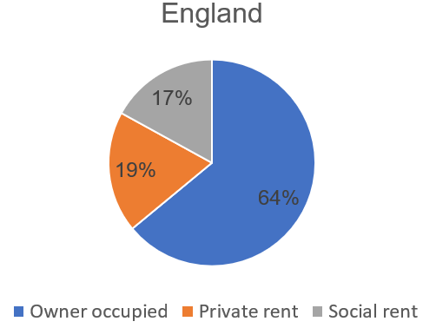
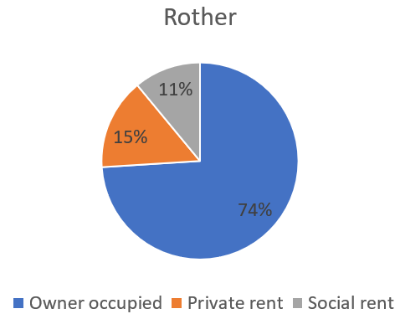
Housing Tenures

Slide 6
Affordable Housing Supply vs Assessed Need
The latest housing needs analysis shows a need of over 300 affordable homes per annum with the average delivery over past 5 years has been 84 affordable homes per annum
Year​ | Affordable Housing Delivered | HEDNA supply requirement​ | Shortfall​ | Cumulative shortfall​
2018/19​ | 60​ | 295​ | 235​ | 235​
2019/20​ | 114​ | 295​ | 181​ | 416​
2020/21​ | 43​ | 295​ | 252​ | 668​
2021/22​ | 112​ | 295​ | 183​ | 851​
2022/23​ | 90​ | 295​ | 205​ | 1056​
2023/24 (projected)​ | 80​ | 295​ | 215​ | 1271​

Slide 7
IMPACT – Affordability The Lower Quartile (cheapest 25%) of Open Market Sale housing​
​
The same ratio in 2002 was 5.92 and in 2012 it was 8.96​
Year​ | 2018​ | 2019​ | 2020​ | 2021​ | 2022​
Average Lower Quartile price​ ​ | £205,000​ | £212,000​ | £225,000​ | £252,000​ | £245,000​
Lower Quartile affordability ratio​ | 10.91​ | 9.87​ | 10.40​ | 11.13​ | 10.70​

Slide 8
IMPACT - Homelessness Demand
There has been a significant rise in demand for the service in 2021/22 as we emerge from the pandemic with the number of assessments and prevention duties owed rising by approximately 30% compared to 2020/21.

Slide 9
IMPACT - Temporary Accommodation
The number of households in temporary accommodation (TA) continues to rise steadily as a result of increased demand.

Slide 10
Main Challenges
Insufficient housing supply and barriers to development
House price and rent cost increases
Low-quality housing and management standards
Carbon reduction targets – impact on standards and viability of new developments
Insufficient affordable housing supply
House price and rent cost increases
Low-quality housing quality and management standards
Carbon reduction targets – impact on standards and viability new developments

Slide 11
East Sussex Housing Partnership
A multi-agency group of the five local housing authorities, housing providers, health and social care partners, the VCSE, Probation and representatives of the Department for Levelling Up Housing and Communities and Homes England
Strengthening its links with other strategic partnerships across the region, including East Sussex Chief Executives Groups, and the Sussex Health and Care Assembly
Specialist groups including Development and Enablement, Housing Management and Standards and Homelessness, Health and Support Groups.

Slide 12
Jeff Pyrah Planning Policy Manager Rother District Council

Slide 13
Rother District Council Housing Development Event
How can Homes England support development opportunities?
mayling.blackburn@homesengland.gov.uk
joshua.hemmings@homesengland.gov.uk

Slide 14
Richard White Executive Director of Development Southern Housing

Slide 16
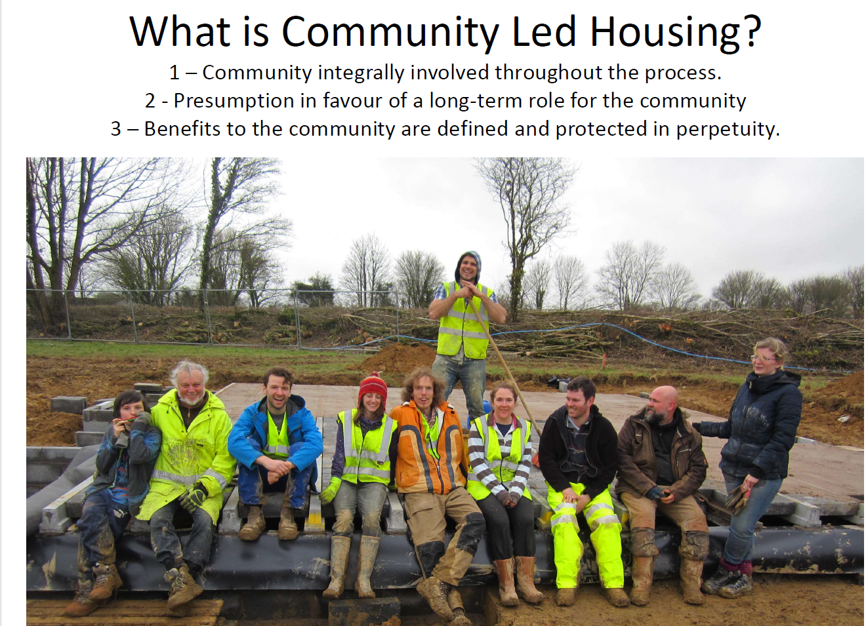

Slide 19
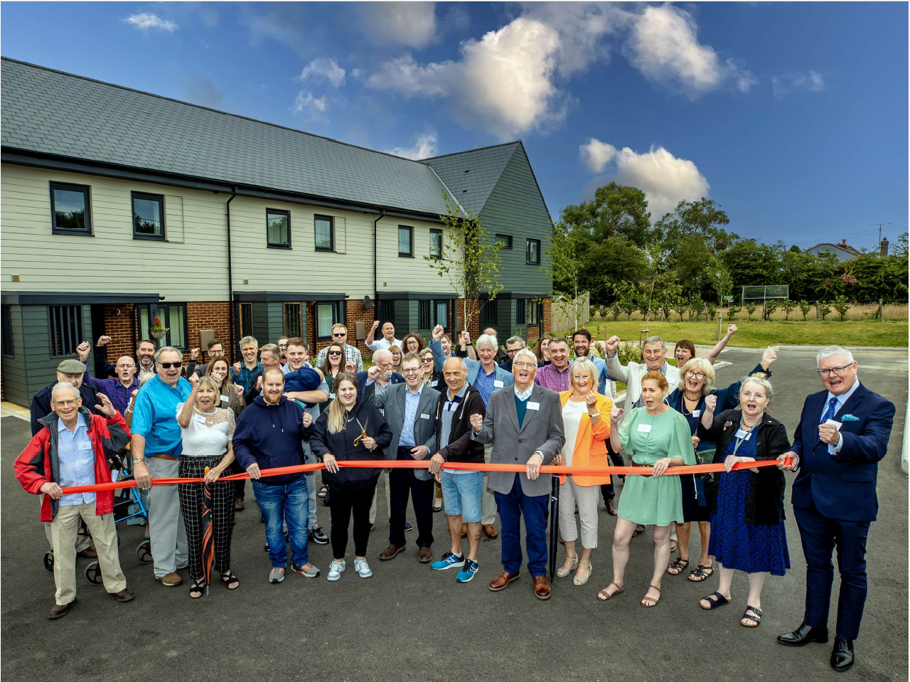

Slide 21
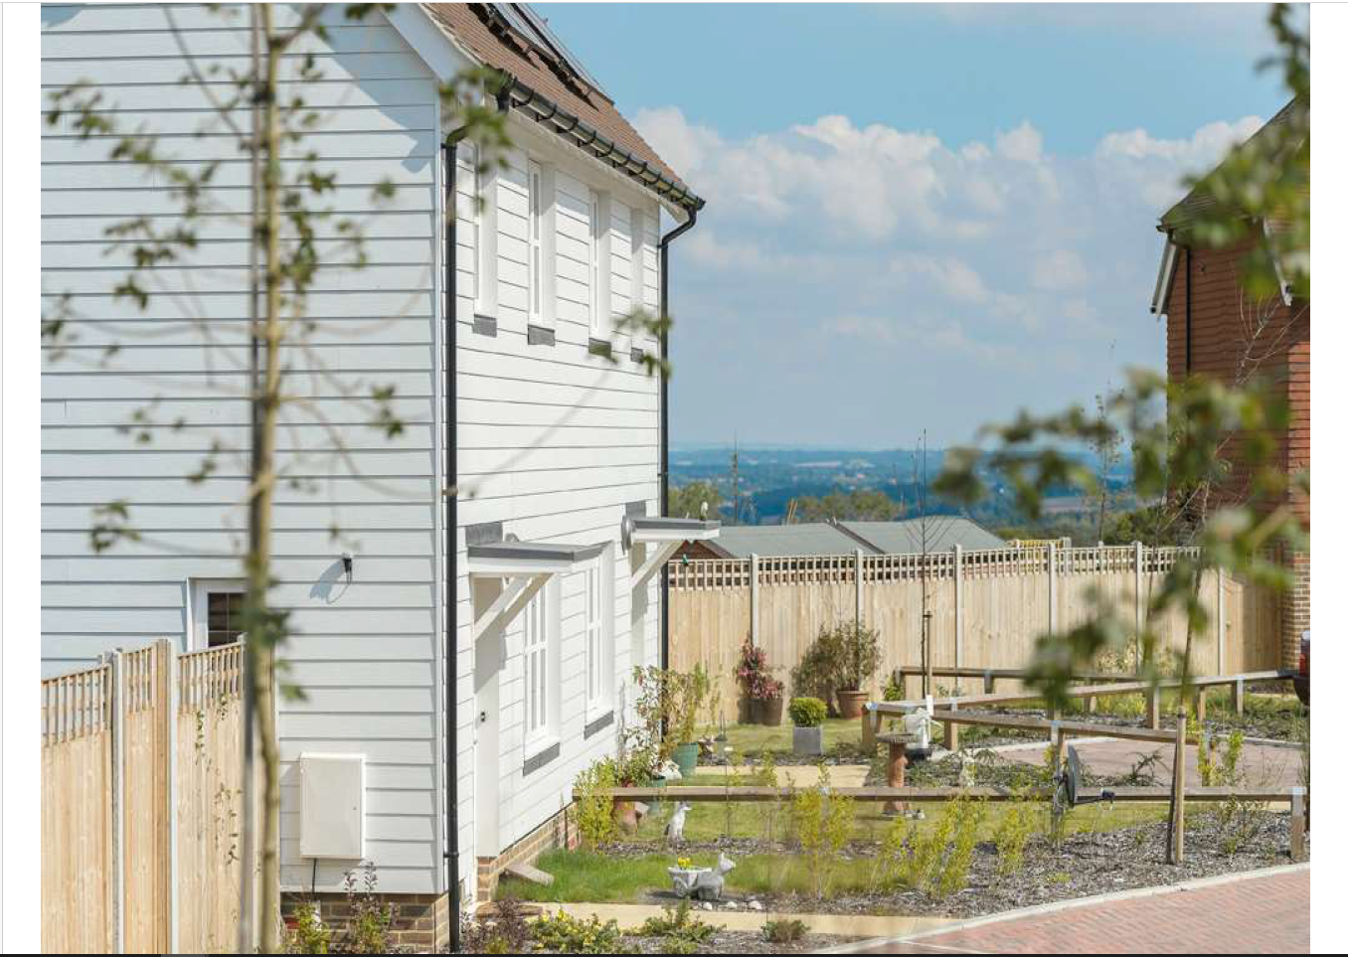

Slide 22
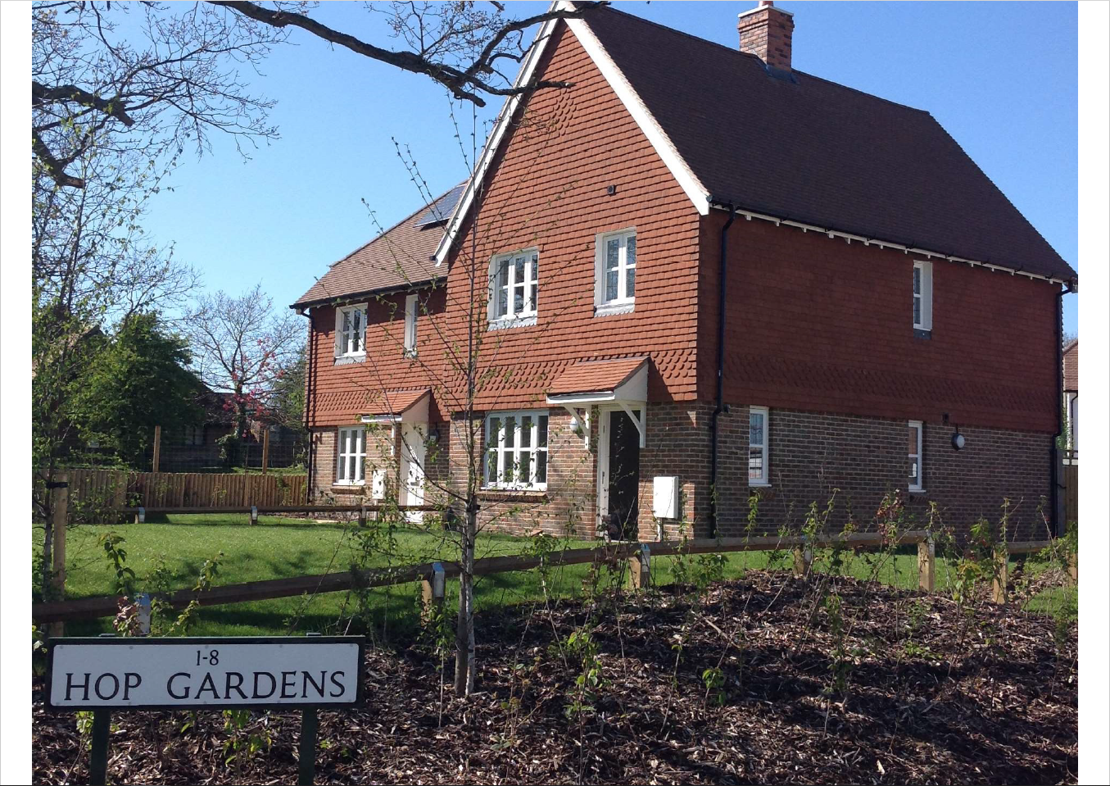

Slide 23
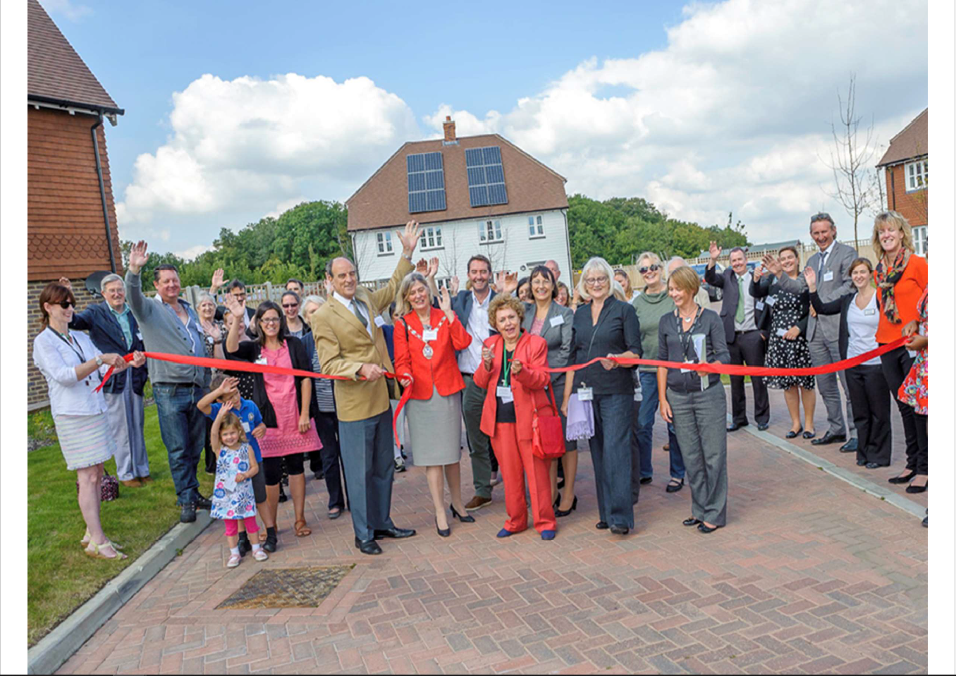

Slide 24
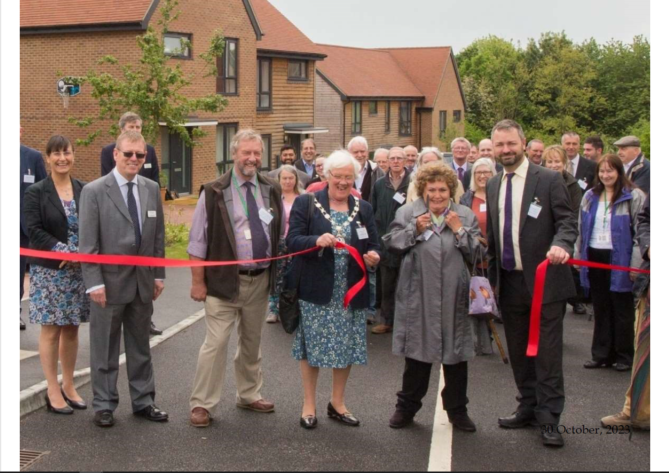

Slide 25
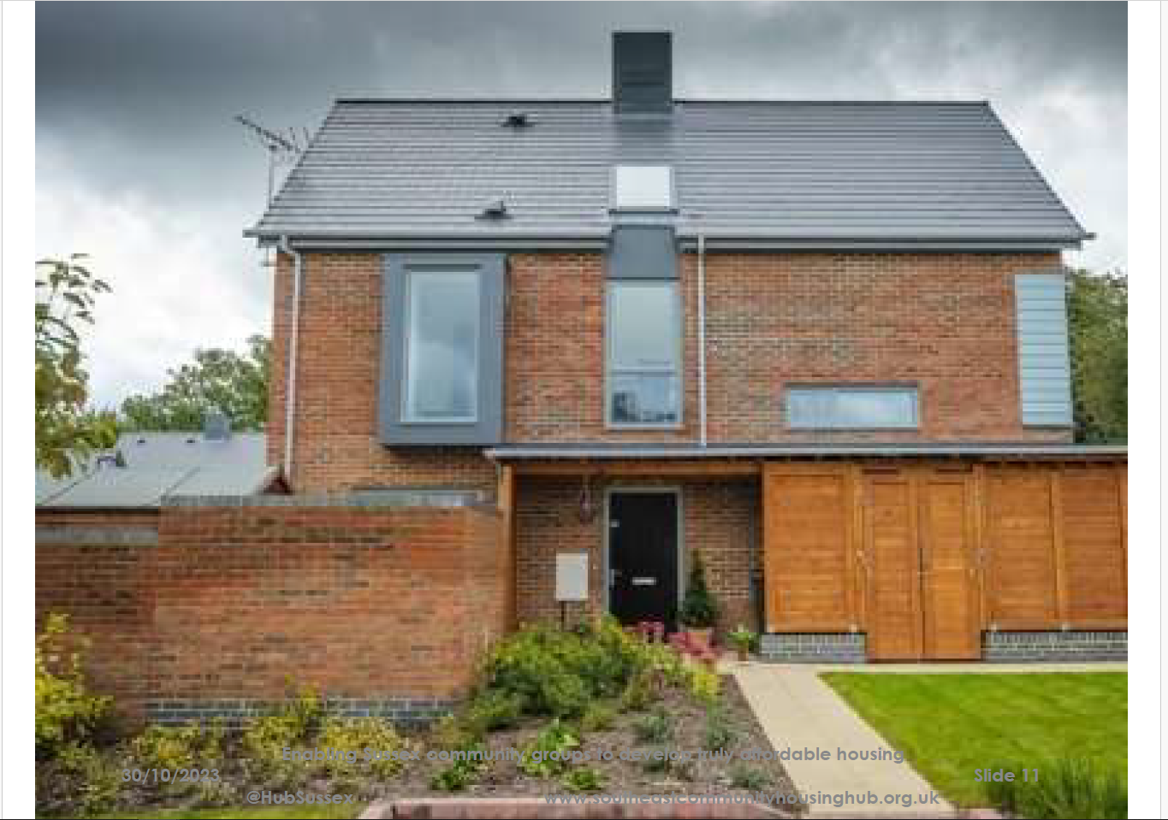

Slide 26
Jonathan Buckwell Developers East Sussex & DHA Planning

Slide 27
Q & A session What questions do you have for our panel? Facilitated by Brian Horton, Strategic Housing Adviser to SELEP

Slide 28
Break to 11.45

Slide 29
Round table discussion Introduced by Joe Powell, Head of Housing & Regeneration
Thinking about the challenges and constraints that exist in Rother, what opportunities are there to increase residential development across the district

Slide 30
Cllr Ruairi McCourt Lead Member for Housing

Slide 31
Lunch Thank you very much for attending our event today Please complete a feedback form and return it to a member of RDC staff
Any further queries or to follow up on anything you’ve heard today please email Graeme.Quinnell@rother.gov.uk

