Slide 1

So what is planning all about?
An Introduction to planning basics
Flo Churchill MRTPI FRSA FCMI
Chartered Town Planner

Slide 2
We are going to cover:-
The benefits of planning
The planning system at present
The role of the Parish Council in the Development Plan
The role of the Parish Council in planning
What is predetermination and what is predisposition?
Enforcement
New and emerging legislation and guidance

Slide 3

The benefits of the planning system
We have a planning system to regulate the development and use of land in the public interest and not to advance or harm the interests of any individual or organisation
We have a planning system to balance the need for development ( such as homes, jobs or infrastructure) with the need to protect and enhance important features of the local environment
We have a planning system to help deliver sustainable development that meets social and economic needs whilst not compromising the legacy to future generations
We have a planning system to test proposals through the planning application process and to giving a say to people affected by development
We have a planning system to control unauthorised development
The objectives of the English planning system are set out in Paragraph 8 of the National Planning Policy Framework (“The Framework”)
The planning system should be genuinely plan-led.

Slide 4
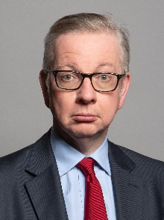
The main players in the planning system
The Secretary of State for Levelling Up, Housing and Communities
Has ultimate responsibility for the planning system in England
Current The Secretary of State is Michael Gove
Promotes new planning legislation in UK Parliament
Prepares, amends and publishes National Planning Policy Framework (NPPF)
Considers and if necessary intervenes in local plans
Considers planning applications for major national infrastructure and “call in” applications from LPAs
Determines planning appeals -majority are delegated to the Planning Inspectorate
Considers various statutory notices referred to him by local authorities

Slide 5
Even More Main players
County Councils
Some areas have two-tier local government with both county and
district / borough councils .
Some County Councils are seeking to regain a strategic planning role.
County Councils cover large areas , but have limited planning roles including:
Planning policies for minerals and waste development
Planning applications for minerals and waste development
Planning applications for their own operational development such as schools , care homes , libraries, roads etc known as ‘County Matters’
County Councils are important consultees in the planning process as:
  The Highway Authority dealing with highway safety matters and road planning
  Lead Local Flood Authority

Slide 6
Yes even more main players
Borough and District Councils
Operating alongside County Councils in some parts of England and typically cover medium and smaller size towns and rural areas. 201 in England ( Big cities and some counties ( such as Northumberland, West Berkshire, Herefordshire and Wiltshire) combine both sets of functions).
Planning responsibilities of boroughs/districts include :
to produce a development plan (local plan) for their area ( except for minerals and waste)
to support towns and parishes on neighbourhood plans
to decide most planning applications ( except minerals and waste)
to enforce planning control
to conserve and enhance the local environment
set Community Infrastructure Levy (CIL)
a range of other planning functions such as appeals,
tree protection , conservation areas, CPO etc.

Slide 7
Yet more main players
Town and Parish Councils
The closest tier of local government to the community , operating at the small town or village level , with over 8,500 in England and have an important role in the planning system through Neighbourhood Plans. They :
Have a statutory right to be consulted on planning applications but cannot determine applications – they can make recommendations so check the wording that you use
Are important consultees on any planning policy documents being drawn up by counties districts and National Park Authorities
Can prepare neighbourhood plans
Can do local conservation and improvement works ,if they wish
They can exercise the “ Community Right to Build” https://www.gov.uk/government/publications/2010-to-2015-government-policy-localism/2010-to-2015-government-policy-localism#appendix-1-community-right-to-build
They can determine how to spend some of the proceeds of Community Infrastructure Levy (CIL) arising from development in their area and have more freedom to determine what CIL monies are spent on compared to LPAs

Slide 8
The role of the Parish Council in Planning- Neighbourhood plans
Since the Localism Act 2011 , town /parish councils have been able to prepare neighbourhood plans so that plans are made by the people most affected by them
The neighbourhood plan :
  Becomes part of the Statutory Development Plan once it has been formally “made” and therefore is the starting point for determining development decisions
  Establishes detailed planning policies for its area – or can be concerned with a more limited number of issues
  Can now allocate large as well as small and medium sites for housing
  Can identify sites for new development but not for a lesser amount than indicated in the local plan
  Can identify key features of the built and natural environment to be preserved and enhanced and suggest areas for designation as Local Green Space (although this must be confirmed by the LPA)
But it must :
  Be prepared within the framework set by national and local planning policy
  Meet any national legal requirements ( such as Habitat Regulations)
  Show that it has engaged with the local community and taken account of their views
  Be tested by an independent examiner and endorsed by local referendum
Changes may be afoot
  Planning White Paper suggested that the content of Neighbourhood Plans needs to be more focused
  The scope and scale of Neighbourhood Plans may change to allow smaller areas such as streets to prepare one

Slide 9
The role of the Town and Parish Council in planning applications
The Town or Parish Council is a statutory consultee with the right to be consulted about planning applications in their area
The Town or Parish Council cannot determine an application unless the power has been delegated to them.
Remember that most planning applications ( over 95 %) are determined by officers on behalf of the Council – so called delegated decisions
Often if the Town or Parish Council objects to a planning application it will be determined by the Planning Committee and the Parish Council often have the right to attend and speak
The Town or Parish Council represents the local community and can engage in consultation with developers on behalf of the community

Slide 10
The role of the Town or Parish Council in making decisions
Whilst the Town or Parish Council is not a decision maker in the determination of planning applications it is still a requirement that the Town or Parish Council makes reasonable decisions
It is good practice for the Town or Parish Council to be able to show that they have taken into account relevant factors when making a recommendation
Individual Town or Parish Councillors do not make decisions but the collective view of the Town or Parish Council will be taken into account.

Slide 11
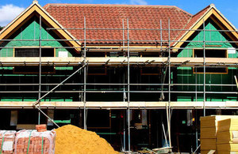
What is “development” and does it need planning permission
Development is defined by section 55 of the Town & Country Planning Act 1990 as follows:
“ the carrying out of building , engineering, mining or other operations in , on , over or under land , or the making of a material change of use of land “
In a bit more detail, this can mean :
  building: erecting new buildings, altering or adding to existing buildings , rebuilding or demolition
  engineering: roads , utility works, excavations, waste disposal
  other operations: anything else that changes the character of land such as some agricultural operations, mounding for flood defences, some advert displays, masts and aerials
  material change of use: the use of a building or land for a purpose outside the existing use class , as defined in the T&CP Use Classes Order 1987(as amended)

Slide 12
What is Permitted development?
Not all development ( operations and change of use ) needs to obtain planning permission
GPDO – Town & Country Planning ( General Permitted Development ) Order 2015 (NB further amendments in 2016, 2017 and 2019)
GPDO Schedule 2 provides exemptions from planning permission
Parts 1-19 : Lists 19 different types of operations which are “deemed to have consent” by Parliament
Permitted development rights are less extensive in “designated areas” under GPDO in National Parks , AONBs, Conservation Areas , World Heritage Sites, and certain important wildlife sites , because these areas are especially sensitive to change
The current GPDO is online at :GDPO Schedule 2

Slide 13
Expanded rights
Scope greatly expanded in recent years to cover :
B1 (office) to residential
Office, hotels, residential institutions, leisure to free schools.
Offices, hotels, residential institutions, leisure, to nurseries
Shops to dwellings
Existing agricultural buildings to create a maximum of 5 dwellings
within floors pace limits
Agricultural buildings (up to 500 sq. m) to school or nursery.
And is continuing to be expanded to cover:
Additional residential storeys on existing purpose built blocks of flats, conversion from commercial to residential etc

Slide 14
The latest changes
Government has extended PD rights on several occasions to “support economic growth, provide more housing , bring land and buildings back into use , and reduce bureaucracy”
The latest changes came into effect on 1st August 2020 with The Town and Country Planning (General Permitted Development) (England) (Amendment) Order 2020. Those changes included:
  A new permitted development right to allow free standing and redundant commercial and residential buildings to be demolished and rebuilt as residential within the existing footprint but not within National Parks, Conservation Areas or involving Listed Buildings
  A new permitted development right for the upward extension of existing buildings subject to prior approval and certain exclusions. The overall height of the extended building must not exceed 30 metres and the overall height of the roof of the extending building must be more than 7 metres higher than the existing roof
  Councils will be allowed to refuse Permitted Development conversions that are windowless or lack adequate natural light
Due to the Corona Virus Pandemic the government also said that planning permissions that were due to expire from the beginning of lockdown to the end of 2020 would be extended to 1st May 2021 – this has not been extended again

Slide 15
So how planning decisions are made ?
The Local Planning Authority 'may grant planning permission, either unconditionally , or subject to such conditions as they think fit, or they may refuse planning permission.'
Town and Country Planning Act, 1990
The determination must be made in accordance with the (development) plan unless material considerations indicate otherwise.’
Section 38(6) Planning and Compulsory Purchase Act 2004
What does this mean?:
The development plan is the starting point for decisions including any ‘made’ neighbourhood plans
Material considerations also have to be identified and weighed in the balance
If material considerations weigh against relevant development plan policies , they will normally need to be significant in order to override planning policy
Applications have to be determined on their individual merits having regard to the development plan and other material considerations

Slide 16
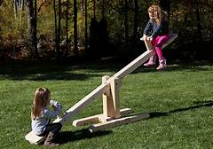
More guidance on making decisions
NPPF paragraph 11 states that (a) planning law and (b) achieving sustainable development has the following implications for decision making on planning applications:
approving development proposals that accord with an up-to-date development plan without delay;
or where there are no relevant development plan policies, or the policies which are most important for determining the application are out-of-date, granting permission unless:
i. the application of policies in this Framework that protect areas or assets of particular importance provides a clear reason for refusing the development proposed;
or ii. any adverse impacts of doing so would significantly and demonstrably outweigh the benefits, when assessed against the policies in this Framework taken as a whole.
This is the so-called “tilted balance” or presumption in favour of sustainable development

Slide 17
What does the NPPF say on making planning decisions
NPPF 2021 (paragraphs 38-50) says :
Decision makers should :
  Approach decision making in a positive way to foster delivery of sustainable development
  Look for solutions rather than problems
Promote pre-application discussions to make the formal application stage as smooth as possible:
  Engage in early discussions between applicants and LPA / key consultees
  Engage with the local community and parish councils where appropriate
  Resolve technical issues as far as possible
  Clarify requirements for information to support a planning application
  Consider a Planning Performance Agreement to project manage complex applications

Slide 18

Materiality and weight
These are two of the most important concepts in planning and it is very important that you understand them
Materiality: whether – given the individual circumstances of a case - a matter is relevant to the planning decision on the development and use of land, and so should be taken into account as a material consideration in coming to a decision
This is a matter of law and there is a huge amount of case law on it.
Weight: the relative importance to be attached to a material consideration in coming to a decision
This is an individual matter of judgement for the decision maker ( who may be an elected councillor on a Planning Committee , a planning officer making a recommendation , the Secretary of State, or one of his Inspectors)
In exercising this judgement , the decision maker must act
reasonably and the reasons for the decision should be clear and
rational. ( Planning authorities have been challenged in the courts
for “ acting perversely” )

Slide 19
What are material considerations?
A material consideration is a matter that – given the individual circumstances of the case- should be taken into account in determing a planning application
In principle , any consideration which relates to the development and use of land is capable of being a material planning consideration. Whether a particular consideration falling within that broad class is material in any given case will depend on the circumstances ( Stringer v MHLG 1971)
Material considerations must be genuine planning considerations which relate to the development and use of land in the public interest. The consideration must also fairly and reasonably relate to the application concerned ( R v Westminster City Council ex parte Monaghan 1989)

Slide 20
Exercise - Material considerations
Which of the following matters can be material considerations in planning decisions ?
Impact of development on the view from a private house
The personal circumstances of an applicant or an objector (e.g. age, health, disability, wealth)
The number of objections vs. the number of supporting representations
“Moral” objections , for example on betting shops ,sex shops, or pay day lenders
Parliamentary statements on planning by Ministers
Previous planning history of the site ( past applications and appeals and decisions on them)
Animal welfare
Loss of trade to a business which would compete directly with the proposed development
Adverse trading impact on a town centre as a whole
A “conservation area” or “listed building” designation
The fear that development may “devalue” a nearby property
The applicant‘s alleged character or behaviour ( either good or bad !)
The ethnicity of the applicant
Whether or not the developer owns the application site
Restrictive covenants and other legal restraints ( such as boundary disputes) that may affect the application site
The developer has started work before the planning application has been decided
Fire precautions in a building
Storage and handling of hazardous materials
Ground / slope stability
Access for disabled people, in a building to which the public have access
Lack of information on the application form
Incorrect notices on the application form
Incorrect fee paid for the planning application
Pre-application advice
Residential amenity
Parking and highway safety
Local and government policy
Nature Conservation and biodiversity
Effects on Listed Buildings and Conservation Areas
Air pollution

Slide 21
These are NOT material considerations
The alleged character or behaviour of an applicant
The fact that development has begun ( LPAs cannot “punish” a retrospective application)
Except rarely, the personal circumstances of an applicant
“Trade objections” from commercial competitors
“Moral objections” , for example on betting shops and pay day lenders
The belief that the developer intends to make a big profit
Boundary disputes
Loss of financial value arising from the proposed development
The fact that the applicant doesn’t own the proposed development site
Private property rights , or legal restrictions such as covenants ( although these may prevent a planning permission being implemented)
Matters covered by other legislation ( such as Building Regulations , Environmental Health , alcohol and entertainment licences )
No matter how often or vociferously these points are raised by objectors , they cannot be considered by LPA in making a decision on a planning application . If it did , it could be exposed to legal challenge
THIS IS NOT AN EXHAUSTIVE LIST !
Give some thought to developing a list of material considerations as an aide memoir

Slide 22
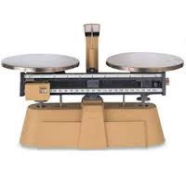
Weighing it all up : the planning balance
1. Identify the relevant national and local planning policies affecting the proposed development
2. Identify other material planning considerations
3. Identify which of the above are positive and support the grant of planning permission
4. Identify which of the above are negative and do not support the grant of planning permission
5. Consider whether any of the negative factors should be the subject of negotiation with the applicants to secure revised proposals, or can be satisfactorily mitigated by planning conditions or a planning obligation
6. Use judgement to determine whether –on its individual merits- the application should be recommended for approval , approval with conditions and/or legal agreement , or refusal

Slide 23
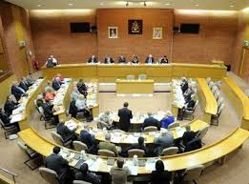
So who makes the decisions?
Planning and other applications can be determined in three ways;
- by LPA councillors through the Committee process
- by officers under delegated powers – so made on behalf of the members
- by the Secretary of State if “called in”, or referred on appeal
Most authorities delegate over 95% of all application decisions to officers
Most LPA Planning Committees meet every 3/4 weeks . All meetings are open to the public although technically speaking they are not ‘Public Meetings’
There is often a public “Opportunity to Speak Scheme”, allowing both supporters and objectors to address the committee at the point of decision but you will need to ‘book’ your right to speak . Parish and Town Councils can often speak in addition to supporters and objectors – Check with your local LPA

Slide 24
Predetermination v Predisposition
Predetermination or bias can lead to problems. It can arise where a councillor is closed to the merits of any arguments relating to a particular issue, such as an application for planning permission, and makes a decision on the issue without taking them into account. Councillors must not even appear to have already decided how they will vote at the meeting, so that nothing will change their mind. This impression can be created in a number of different ways such as quotes given in the press, and what they have said at meetings or written in correspondence. Rarely will membership of an organisation, such as a national charity, amount to predetermination or bias on its own unless it has a particular vested interest in the outcome of a specific decision that a councillor is involved in making
Predisposition - There is an important difference between those councillors who are involved in making a decision and those councillors who are seeking to influence it. This is because councillors who are not involved with making a decision are generally free to speak about how they want that decision to go. When considering whether there is an appearance of predetermination or bias, councillors who are responsible for making the decision should apply the following test: would a fair-minded and informed observer, having considered the facts, decide there is a real possibility that the councillor had predetermined the issue or was biased? However, when applying this test, they should remember that there is nothing wrong in a councillor to be predisposed towards a particular outcome on the basis of their support of a general policy. This is as long as they are prepared to be open-minded and consider the arguments and points made about the specific issue under consideration.
Members may have been involved in development proposals before they reach Committee. Members who have taken formal decisions about development proposals, or who have been closely involved with officers responsible for such proposals, are advised not to take part in making planning decisions about such proposals.

Slide 25
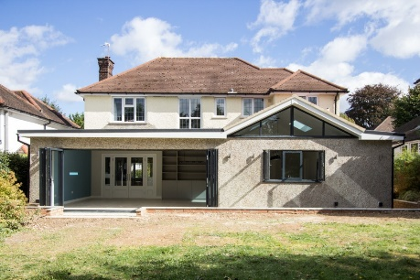
The need to seek planning permission
Planning permission is required for the carrying out of any development of land as defined by the T&CP Act 1990 , section 57
But Parliament has decided that it doesn’t want the planning system to be bogged down by handling masses of small developments with very little environmental impact
So legislation grants permitted development rights to a wide range of developments such as smaller house extensions, walls and fences , some agricultural developments, work by local authorities and utility companies, and some larger developments in complexes like hospitals , airports , seaports, and universities with little external impact. These rights have increased and are continuing to change under the current government
Likewise the Use Classes Order permits changes within the same Use Class such as a bookshop to a clothes store without requiring a planning application and these rights are also being amended in response to the Covid crisis
Assessing whether a proposal benefits from permitted development is often legally complex and you should always check with local planning office if unsure

Slide 26
The planning application and appeal processes
Key stages in processing applications
1. Pre-application discussions
2. Validation , registration, allocation of reference number and case officer , bank payment of application fee ( Clock starts here)
3. Consultations : some statutory , some elective
4. Site visit(s)
5. Assessment after consultations:
Officer assessment and views received
Need for negotiation / amendment and re-consultation / legal agreement ?
Decision route: delegated or committee?
6. Officer report
Decision and formal notification to applicant and all responding consultees
Record on Planning Register
LPA has to make decision within 8 weeks for most applications (13 /16 weeks for some major applications), but can be extended by agreement
Application site visits can be carried out in line with current practice relating to Covid 19
21 days are generally allowed for consultees/neighbour’s views but can be extended by agreement
Strong Government pressure to meet performance targets
LPA can be “placed in special measures” if performance is considered to be weak or slow

Slide 27


Applications for development
There are different types of planning application
Full planning permission
    Shows all the details of the development
Outline planning application
    Establishes principle of development only
    Details ( known as Reserved Matters ) usually left for subsequent submission , but can be considered at outline stage if critical to development (e.g access)
    Can be accompanied by illustrative material , but this is not part of the application or binding on the applicant so remember this when making recommendations
    The LPA may decline to determine outline applications in sensitive areas and require a full application
            Reserved Matters
              Filling in the details of an outline
              May change from the Outline application

Slide 28

Different types of applications :
Lawful Development Certificates (LDCs)
Local planning authorities can grant a certificate saying that:
  an existing building , or use of land, is lawful
  a proposed building , or use of land , is permitted development and would not require a specific grant of p.p. and so is lawful
Applicants must submit accurate and truthful information
Consideration of LDCs not based on planning merits , but on factual evidence on history and planning status of the site and interpretation of planning law
Applicant can appeal if turned down
LDCs can be useful when:
  The planning status of site in dispute,
  especially where property is being bought and sold
  Resolving some planning enforcement cases

Slide 29

More applications
Temporary permission
  For short life buildings ( e.g. Portacabins) or changes of use where the Council wishes to assess impact before considering a permanent application
Permission to retain building or use , but varying , or without complying with a planning condition on a previous planning permission
  Where an applicant feels existing planning conditions are too onerous or no longer relevant
  So ask yourself why was the condition originally imposed ? Have there been any significant changes since that time ? Has guidance or legislation changed?

Slide 30
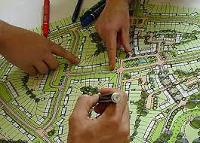
Special types of planning control
There are a number of special forms of control in the English planning system which go above and beyond the requirement for planning permission . These are:
Conservation Areas
Listed Buildings
Tree Preservation Orders
Ancient Monuments
Advertisement Control
All are the subject of specific legislation and add further complexity to the system

Slide 31
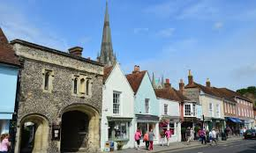
Conservation Areas
Statutory definition : “Areas of special architectural or historic interest , the character or appearance of which it is desirable to preserve or enhance”
Designated by LPAs: no national standard and vary greatly from city centres to historic towns to small villages
The Parish Council can petition for a new Conservation Area (CA) to be introduced
There are more than 9000 CAs in England .
Not a block on new development , but development within a CA must look to enhance or better reveal the significance of the CA
Additional controls apply – demolition within a Conservation Area often needs permission
LPA should publish appraisal and proposals for enhancement but many are woefully out of date

Slide 32
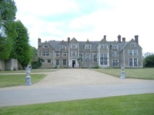
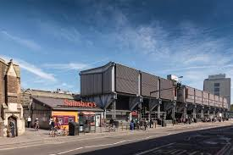
Listed Buildings
National list drawn up by Sec of State for Culture , Media and Sport.
Covers most buildings pre-1840, but increasingly selective on later buildings
Covers not only buildings , but also structures like walls , mileposts, graves , horse troughs.
About 374 ,000 LBs in England
Grade 1 : most exceptional buildings (2.5%)
Grade 2* :particularly important (5.5%)
Grade 2 (92%) : buildings of special interest.
Details of special controls ( Listed Building Consent) at
  https://www.english-heritage.org.uk/caring/listing/listed-buildings/

Slide 33

Tree Protection
LPA can impose a Tree Preservation Order (TPO) to protect trees with special amenity value
TPOs prevent destruction , topping or lopping of trees without prior consent of LPA
TPOs can apply to individual trees, groups of trees or woodlands
There are exemptions for dead , dying or dangerous trees and fruit trees cannot be covered under TPOs
Fines for unauthorised works – can be substantial

Slide 34
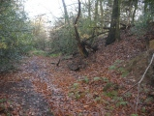
Ancient Monuments
National designation since 1882 for important archaeological sites by Sec. of State for Culture, Media and Sport
Any works involving demolition, removal, alteration or repair to monument need consent from SSCMS
LPAs are consultees only
Over 19,700 Ancient Monuments in England
More info at:
http://www.english-heritage.org.uk/caring/listing/scheduled-monuments/

Slide 35
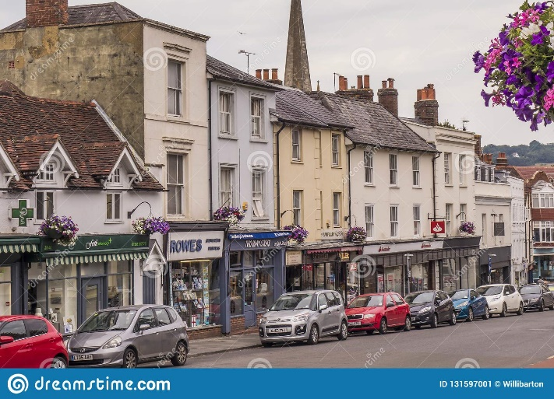
Advertisement Control
A separate arm of planning control in the Town & Country Planning (Control of Advertisements) Regulations 2009 : very detailed and complex
Regulations divide advertisements into three types
Adverts that don’t need consent
Adverts that have “deemed consent “ within certain size and height limits
Adverts that need “express consent “from the LPA
Control can only exercised in interests of “amenity” and “traffic safety”
Appeals can be made to Sec. of State for Housing , Communities and Local Government

Slide 36

What decisions can the LPA make?
Planning permission without conditions ( this is rare and only with very simple applications)
Planning permission with conditions**
  a) necessary to make the development acceptable in planning terms;
  b) directly related to the development; and
  c) fairly and reasonably related in scale and kind to the development (NPPF paragraph 56)
…..and in some cases also a planning obligation ( a legal agreement between the developer and the LPA that certain actions will be undertaken )
Refusal of planning permission** with reasons
___________________________________________________________
** The applicant may appeal to the Sec of State if unhappy with these outcomes

Slide 37
Section 106 agreements and other planning obligations and Community infrastructure Levy (CIL)
Section 106 agreements and CIL are all about delivering sustainable development , by ensuring that development is supported by necessary infrastructure and that it operates successfully
Most development is controlled by planning conditions
Where this is not possible there may be a need to consider s.106 or CIL
Section 106 is a legal agreement between developer , local planning authority and other parties to secure certain things to make the development acceptable ( may require the applicant to do things / not do things/ or pay money to enable local authority to do things)
Occasionally a developer may opt to offer a Unilateral Undertaking (UU)which is a legal promise to provide certain monies for issues related to the development. A UU can be legally enforced.
CIL is a levy on development based on £/m2 of floor space based on a Local Planning Authority charging schedule agreed after extensive research , debate and independent scrutiny
When certain milestones are met CIL funding is gathered from the developer and then allocated to a infrastructure to support new development (15/25% to town/parish councils depending on whether there is a made Neighbourhood Plan in place.)
Section 106 operates alongside CIL for on-site requirements , such as social housing
Further reforms are likely to CIL – watch this space

Slide 38
How to make Parish Council views count on planning applications
Look carefully at all the application documents and make sure you understand what the applicant is proposing. If possible , go and see the site for yourself.
Ask the Clerk to speak to the case officer , if any clarification is required
Consider the proposed development on the basis of relevant planning policies and material planning considerations
Respond to LPA within set timescales : if there is a difficulty , the Clerk should speak to the case officer to see if the time limit can be extended
Make it clear whether the Parish Council :
> has no objection or no comments OR
> supports the application and reasons why OR
> objects to the application and reasons why
If the Parish Council feels strongly about an application ask your local authority ward member to call it in for determination by Committee, and attend Committee and speak about your support or opposition

Slide 39

What if it goes the other way … ?
Sometimes, the LPA may arrive at a decision different to the Town/Parish Council view . There may be good reasons for this:
The Town/Parish Council is consulted early in the process before views are available from key consultees , neighbours etc. However , these will be available to LPA when they are making a decision
LPA may have negotiated changes to the submitted application , imposed planning conditions or secured a legal agreement to overcome particular problems
LPA has the benefit of advice from professional planning and legal officers
The Parish Council may have taken into account non-material considerations in coming to a view, or suggested reasons for refusal or conditions that cannot be sustained ( often the case on highway matters)
If there are persistent problems , or particular issues , talk to LPA

Slide 40

So It’s a No then –
Planning Appeals
Appeals can be made against refusal , or imposition of conditions, or refusal of ‘prior approvals.’
There are three different types of appeal format :
> Written representation (including householder) : an exchange of written representations by the appellant , LPA and other interested parties
> Informal Hearing: a structured discussion led by a Government Inspector who sets out the key issues in the case
> Public Inquiry : a formal event involving presentation of cases by lawyers , presentation of evidence by professional and other witnesses and cross- examination by opposing lawyers and the Inspector
The Inspector will visit the site ( sometimes “accompanied” , sometimes not)
There are no 'third party' rights of appeal in England even if residents etc. aggrieved by grant of permission
Town/Parish Councils will be consulted and may take part in hearings or inquiries
Normally , all parties bear their own costs

Slide 41
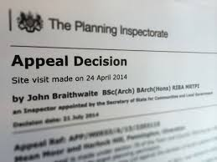
The appeal process
The process is managed by the Planning Inspectorate based in Bristol , who set firm deadlines for submission of material
Process depends on format selected : The Planning Inspectorate decides the appropriate format appropriate to the case.
Large and complex cases may go to Public Inquiry
A written decision usually released by the Inspectorate (“allow” = grant permission / “dismiss” = refusal) , who have their own performance standards , although a few decisions are made direct by Ministers
Costs can be awarded in the event of unreasonable behaviour, but this is rare
Waiting times for appeals are now extremely long – on average an enforcement appeal hearing takes 172 weeks!

Slide 42
What is the value of Town or Parish Council involvement?
Voice of the local community
Proven local knowledge
Able to raise areas of concern of the local community
Town or Parish Councils inform the debate and add value to the process
Parish Councils are able to make developers aware of the community needs arising from development and negotiate on behalf of the community

Slide 43
Making the recommendation
Points to think about:-
  Are we being reasonable?
  Are we biased against the developer or the development?
  Are there any precedents from previous appeal decisions on the site
  Are we making consistent decisions?
  What evidence are we basing our decision on?
  Have we taken into account all of the material considerations?
  Is there clear policy support for our recommendation?
  Have we given appropriate weight to the material considerations
  What harm do we think might be caused?
  Would conditions make the development acceptable?

Slide 44
Reasons for recommending support
Why are we supporting the application?
  Does it meet an objective from the NDP or other parts of the development plan
  What benefit do we think the development will bring
  Do we have sound planning reasons to support the application?
State clearly what our reasons are for the decision

Slide 45
Reasons for recommending refusal
If we decide that we cannot support the application and want to recommend refusal we must make sure that our reasons are:
  Based on accurate information and understanding
  Are directly related to the development proposal
  Have had proper regard to the development plan
  Relate to material considerations

Slide 46
Now we are going to cover
Enforcement
Changing policy, guidance and legislation

Slide 47
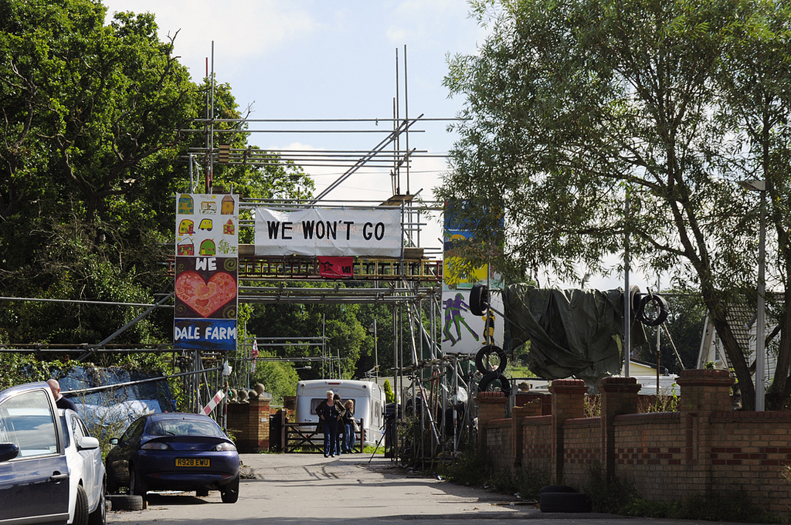
Enforcement

Slide 48
Enforcement
The National Planning Policy Framework says in para 58:-
Effective enforcement is important to maintain public confidence in the planning system. Enforcement action is discretionary, and local planning authorities should act proportionately in responding to suspected breaches of planning control. They should consider publishing a local enforcement plan to manage enforcement proactively, in a way that is appropriate to their area. This should set out how they will monitor the implementation of planning permissions, investigate alleged cases of unauthorised development and take action where appropriate.

Slide 49


Wrong, wrong, wrong
The first step is always to investigate and establish the facts
LPAs will usually offer the landowner the chance to remedy the breach of planning control by removing unauthorised works, stopping unauthorised uses, or – in some cases- applying for retrospective planning permission
If no satisfactory response from landowner , a range of statutory notices can be served requiring action to remedy the breach
Failure to comply with notices can lead to court action or - in the most extreme cases- direct action on site by the LPA when costs can be recovered

Slide 50

What happens when it goes wrong?
Enforcement is essential for the credibility of the whole system
Breach of planning control is not normally a criminal offence except works to LBs and protected trees
‘Enforcement action is discretionary, and local planning authorities should act proportionately in responding to suspected breaches of planning control.’ (para 58 NPPF)
Planning enforcement seeks to be restorative , not to punish the offender ( although there are fines , and even imprisonment, if the courts are flouted )
LPAs welcome local people acting as “eyes and ears”
in reporting possible breaches of planning control,
which they will then investigate, but do not
confront alleged offenders

Slide 51
Enforcement Local Plan
Does your Local Planning Authority have an Enforcement Local Plan?

Slide 52
Why no enforcement action?
After initial investigation, there are several reasons why no action may be necessary because the development ,or use, of land concerned may:
Not need planning permission , or already have it
It is not expedient to take action because of the lack of impact or effect
Be unclear in terms of the extent and impact of any breach , and that the best thing to do is to continue monitoring the site
Be an unauthorised development that it is now immune from planning control under s171B of the Town & Country Planning Act 1990

Slide 53
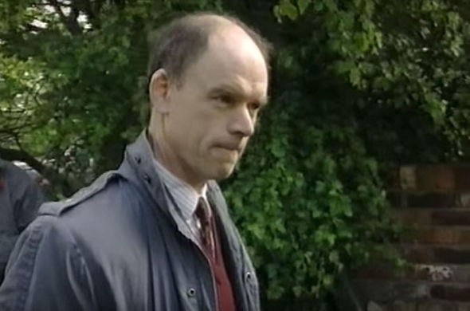
Take Care

Slide 54
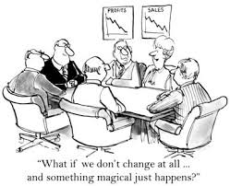
Why change?

Slide 55
Changes in guidance, policy and legislation
Perfect storm of changing guidance, policy and legislation resulting in:
  The Business and Planning Act 2020
  The Corona Virus Act 2020 and Regulations
  The Environment Act 2021
  The Planning Bill
  The NPPF 2021
  Cabinet re-shuffle

Slide 56
Business and Planning Act 2020
The aim of the Act was to kick start Council house building to deliver 100,000 homes per year
The temporary measures set out in the Act were aimed to help encourage the construction and building industry to resume its work

Slide 57
Business and Planning Act 2020
Changes to the planning system were introduced through the Business and Planning Act 2020 which received Royal Assent on 22 July 2020.
The Act included a range of measures to help businesses adjust to new ways of working as a result of Covid-19. In respect of planning, these included:
a) Pavement licences: a new streamlined procedure enabling businesses serving food and drink to apply for a temporary pavement licence
b) Construction hours: a fast track application process for the temporary variation of planning conditions relating to construction site working hours
c) Time extensions: provision to allow the commencement period for certain unimplemented planning permissions and listed building consents to be extended. This is to ensure relevant permissions and consents are still extant, enabling development to commence following delays caused by Covid-19
d) Remote meetings: amendment to the Coronavirus Act 2020 which provides that regulations can make provision relating to requirements for local authorities to hold meetings, the timing and frequency of such meetings, the places at which such meetings must be held, and the way in which people may attend, speak and vote. [NB: Regulations that implemented S78 of the Coronavirus Act were made pursuant to the Local Authorities and Police and Crime Panels (Coronavirus) (Flexibility of Local Authority and Police and Crime Panel Meetings) (England and Wales) Regulations 2020 and come into force on 4th April 2020.]

Slide 58
The Corona Virus Act 2020
Introduced revised and new powers and duties in respect of:
  Collection and use of contact details
  QR codes
  Refusal of entry
  Temporary restrictions on businesses and services
  Health protection – food and drink premises
  Ability to levy fixed penalty notices
  Postponed elections and referendums and postal ballots
  Enforcement in relation to health protection
  Self isolation
  Community Safety
  Quarantine rules

Slide 59
Corona Virus Enabling Regulations
Enabled meetings to be held remotely
Regulations ended 7th June 2021
Planning Meetings are meetings held in public but are not public meetings

Slide 60
The Environment Act 2021
Introduces the need for developers to prove that their sites create an additional 10% ‘Biodiversity Net Gain’
Developers will need to submit a ‘Biodiversity Net Gain Plan’ to accompany their planning applications
Biodiversity gain and loss will be measured using an updated biodiversity metric developed by DEFRA which will assess a habitat in terms of its value to wildlife, its condition and its size.
Net gains will have to be guaranteed by the developer for 30 years
If developers cannot provide net gains on site they will have to buy biodiversity credits to compensate
Costs are not currently known but could add an additional £10,000 to £15,000 per dwelling
Environmental impact assessment will be changed
Still awaiting details and timing of the enabling legislation

Slide 61
Nature Recovery Strategies
The Environment Act obliges local planning authorities to produce spatial local nature recovery strategies (LNRS).
These are intended to better support spatial planning for nature recovery by setting out priorities and opportunities for protecting and investing in nature within a local area".
They must also include a statement of biodiversity priorities for the strategy area and this must include descriptions of ‘the plan area and its biodiversity" and "priorities for recovering or enhancing biodiversity’
They must include a ‘local habitat map’ to show existing nature assets including protected sites and wildlife rich habitats
They must also ‘identify key opportunities for enhancement’.

Slide 62
Office for Environmental Protection
The Act establishes a new public body called the Office for Environmental Protection (OEP) to regulate the UK’s environment after the European Commission ceases to have jurisdiction.
This is intended to be an "independent watchdog with the teeth to hold government and other public bodies to account on their obligations on the environment – including on climate change".
The OEP will have power to apply for judicial review if it thinks a public body has broken environmental laws.
It is expected that the OEP will cover planning-related environmental legislation, including environmental impact and habitats regulations assessments.

Slide 63
Additional Duties
The Act introduces a duty to enhance biodiversity
Amendments to the Natural Environment and Rural Communities Act 2006 proposed by the bill would put councils under a statutory duty to ‘enhance’ as well as ‘conserve’ biodiversity and to publish reports on how they meet this.
This will be another material consideration to be taken into account in determining planning applications
The Environment Act proposes a legally binding target to reduce fine particulate matter (PM2.5) and increase local authority powers to address sources of air pollution.
Some local authorities may be forced to halt permissions temporarily due to high emission levels.
Air pollution will be a factor that needs to be taken into account and will be raised by objectors to development.

Slide 64
What didn’t appear in the Planning Bill
Neighbourhood Plans to any meaningful extend
Parish and Town Councils to any meaningful extent
Measures to increase democracy and participation
Detail of how the changes will be implemented – will there be any transitional arrangements?
Details of enabling legislation before the next parliamentary term

Slide 65
Lack of Details
Clive Betts MP is chair of the Commons Housing, Communities and Local Government Committee has criticised the government for failing to give details of how the forthcoming reforms of the planning system will work in practice.

Slide 66
Delay after delay after delay
Government had intended to respond in Spring of 2021
There have been debates in Parliament about how housing need is calculated
Michael Gove has said that he wants to review the reforms before pressing ahead with them
Government were due to respond to the consultation before Christmas 2021 but now not expected until after consultation on the Levelling Up Bill

Slide 67
Other New Legislation that may or may not come in
A number of Private Members Bills (PMBs) are aimed at dealing with some of the issues raised by the potential reform of the Planning System
Private Members Bills are determined by a Ballot held at the beginning of each new parliamentary session.
All backbench MPs are eligible to take part
They do not need to provide details of their proposed bill at this early stage
20 MPs get the chance to introduce a PMB
Time is devoted on 13 Fridays to discuss PMBs
PMBs can be ‘talked out of time’
Some do make it onto the Statute Books e.g.
  Education (Guidance about costs of school uniforms)Act 2021

Slide 68
Planning Enforcement Bill
A Private Members Bill at 2nd Reading Stage in the House of Commons
A Bill to create offences relating to repeat breaches of planning controls; to make provision about penalties for planning offences; to establish a national register of persons who have committed planning offences or breached planning controls and make associated provision about planning applications; and for connected purposes.

Slide 69
Planning – Proper Maintenance of Land Bill
A Bill to make provision for increased fines for failures to comply with a notice under section 215 of the Town and Country Planning Act 1990
A Private Members Bill currently at 2nd Reading stage in the House of Commons

Slide 70
Planning – Street Plans Bill
A Bill to make provision about the creation and operation of street-level plans for local development; and for connected purposes
Michael Gove is said to support this PMB
A Private Members Bill at 2nd Reading Stage in House of Commons

Slide 71
Planning and Local Representation Bill
Bill to give people who have made representations about development plans the right to participate in associated examination hearings; to require public consultation on development proposals; to grant local authorities power to apply local design standards for permitted development and to refuse permitted development proposals that would be detrimental to the health and wellbeing of an individual or community; to make planning permission for major housing schemes subject to associated works starting within two years; and for connected purposes.
A Private Members Bill currently at 2nd Reading Stage in the House of Commons

Slide 72
The New NPPF
The NPPF sets out the main guidance and policy for the planning system
This has recently been amended and has introduced a number of changes
The NPPF will need further amendment if the Planning Bill becomes law

Slide 73
Recent Changes to the NPPF
Councils will be required to produce new local design codes or guides consistent with principles set out in the National Design Guide and National Model Design Code
A new overarching social objective of the planning system to include “the fostering of well-designed, beautiful and safe places”
A new test that development should be well designed
Significant weight should be given to development which reflects local design policies and government guidance as well as significant weight also being given to outstanding or innovative design

Slide 74
More changes to the NPPF
Beauty is to be treated as an ambition rather than a strict policy test
There is to be an emphasis on using trees in new developments
There are to be limits on restricting permitted development rights via Article 4 Directions
Encouragement to ensure faster delivery of public service infrastructure such as further education colleges, hospitals and prisons
The UN climate change goals have been added
Development Plan policies for proposed large new settlements should have a 30 year vision and this also now refers to ‘significant extensions to existing villages and towns’ This is leading to many local planning authorities claiming the need for a 2 year delay in producing their local plan because prior to the issue of the revised NPPF a 15 year vision was required.
New ‘affordable housing products’ are being introduced

Slide 75
And even more changes to the NPPF
Development plans should manage any residual flood risk by using opportunities provided by new development and "improvements in green and other infrastructure to reduce the causes and impacts of flooding (making as much use as possible of natural flood management techniques as part of an integrated approach to flood risk management)".
Tightened the rules around isolated houses in the countryside which should be ‘truly outstanding’ in design with the word ‘innovative’ having been removed
MHCLG have said they will further review the NPPF to support the commitment to Net Zero
“Where major development involving the provision of housing is proposed, planning policies and decisions should expect at least ten per cent of the total number of homes to be available for affordable home ownership”

Slide 76
Last few changes for now
A new test for urban extensions and new settlements to include a genuine choice of transport modes
Biodiversity should be integrated into development proposals rather than just encouraged
Neighbourhood Plans can now allocate large sites as well as small and medium sites
Government have already admitted that the NPPF will need to be amended further to encompass Zero Carbon ambitions

Slide 77
So What about the Parish Councils?
Government White Paper on Planning for the Future
  How many times do you think the words Parish Council appeared in the recent pages of consultation?
In 83 pages the term ‘Parish Council’ appears only once in Paragraph 4.26
  “Currently, the Neighbourhood Share of the Community Infrastructure Levy ensures that up to 25 per cent of the levy is spent on priorities in the area that development occurred, with funding transferred to parish councils in parished areas.”
The scope of neighbourhood plans may be extended and adapted to allow smaller areas such as streets to prepare a plan and this may impact on the Parish Council role
Changes to the current planning system
  How many times do you think the words Parish Council appeared in the consultation document?
In 40 pages the term ‘Parish Council’ appears only once in Paragraph 110 “We plan to retain the current publicity requirements for statutory consultees and parish councils.”

Slide 78
Planning Protocol
Give some consideration to creating a planning protocol to be agreed by the Parish Council.
This will protect all Councillors in any dealings with developers, agents, applicants or objectors
Should be tied into the Parish Council code of conduct
Should cover:
  Pre application discussions
  Pre application public consultation
  Declarations of interest
  Predetermination and predisposition
  Lobbying
  Attendance at parish council meetings by developers, agents etc
  Public perception and avoidance of bias

Slide 79
How to keep up to date with changes
Take part in any training you are offered
Track the progress of the bills in Parliament
Join the Politicians in Planning Network organised by the Royal Town Planning Institute
Take part in consultations
Ask questions

Slide 80
Where to find more information
The Planning Portal
The National Planning Policy Framework
The National Planning Practice Guidance
Planning Resource (Subscription needed)
CPRE Guide to Planning
Listed Building lists
Planning White Paper
National Model Design Code

Slide 81
Any questions
Flo Churchill MRTPI FRSA FCMI
Planning Advisor

