Slide 1
East Sussex Highways
EASLC AGM
November 2023

Slide 2
Welcome & Introductions
Good Afternoon and Welcome to this presentation about East Sussex Highways
Karl Taylor – Assistant Director, Operations
Dale Poore – Head of Service (Highways)
Ruby Brittle – Stakeholder & Engagement Manager
Nicola Blake – Balfour Beatty Service Director
Questions will be answered at the end of the presentation in the order they are received.

Slide 3
Communities, Economy & Transport
A diverse department covering a range of public facing services, including:
Highways & Rights of Way
Transport Operations & Transport Planning
Waste Disposal
Libraries
Registrations Service
Economic Development & Skills
Trading Standards
Traffic & Road Safety
Planning, Environment & Flood Risk
Parking Enforcement

Slide 4
Highways
Team | Responsibilities
Highway Maintenance | Reactive Maintenance Planned Maintenance Customer Contact Centre Coordination of Utility Works Delivery of Capital Schemes
Traffic & Road Safety | Speed Limits & Traffic Restrictions New Traffic Lines & Signs (ex Parking) Pedestrian Crossing Requests Traffic Calming Requests School Crossing Patrols
Transport Development Control | Highway Land Information Pre-App & Planning Applications S278 & S38 Development Advice on Local Plans
Transport Planning | Manage Local Transport Plan & local Transport Schemes Transport Policy Walking & Cycling Strategy Transport Monitoring

Slide 5
Highway Responsibilities
ESCC is the local Highway Authority
East Sussex Highways is responsible for maintenance of 2000 miles of road
National Highways
Responsible for maintenance of trunk roads (A27, A26, A21 & A259)
District and Borough Councils responsible for:
Litter picking (including clearing leaves)
Road sweeping
Maintenance of “road name” signs
Eastbourne Borough Council look after highway trees and carry out weed control and urban grass cutting on behalf of ESCC behalf
Hastings Brough Council look after highway trees on behalf of ESCC
Utility Companies:
Responsible for their underground equipment, overhead wires, manhole covers, poles and cabinets

Slide 6
Highways Policies and Services
East Sussex Highways work to County Council policies
Policies shape the approach to maintenance and enable us to use our funding and resources efficiently
Our highway contractor, Balfour Beatty Living Places, work to Council Policies and Contract Specifications
Council Policies define intervention criteria that determine what we do and when
The Highway Network comprises:
Over 2,000 miles roads
Over 1,500 miles footways
974 bridges
37,000 street lights
200 signal junctions and crossings
98,000 gullies with chambers, culverts and miles of pipes
Nearly 3,000 miles grass verges and thousands of trees
Thousands of signs, bollards, barriers, road studs and miles of road markings

Slide 7
Highways Policies and Services - Revenue
Revenue works are those which are funded by council tax, business rates and government grants.
Circa £12m budget for works and services including £10.5m for Core Services:
Customer Services (contact centre, communications, website, social media etc)
Highway Stewards (safety inspections, customer case inspections, etc)
Licencing & Enforcement
Claims management (red and green)
Network Management
Winter Maintenance
Grass cutting (Rural and Urban), weed control and hedge cutting
Gully cleaning, ditch and grip maintenance
Safety defect repairs (potholes, basic streetlight and traffic signal repairs)
Minor bridge and tunnel maintenance and repairs plus routine inspections

Slide 8
Cyclical & Routine Works
We carry out annual cyclical maintenance programmes including:
Grass Cutting
Rural areas – two cuts a year
Urban areas – two cuts a year
Weed spraying
Gully cleaning
Ditch and Grip maintenance
Winter maintenance
10,000 tonnes of rock salt
21 gritting routes – both primary (41% of network) and secondary (11% of network)
Over 700 grit bins – but not all are owned by ESCC
Street Lighting & Traffic Signals
Not all street lights are ours
Dependent on power suppliers for connections

Slide 9
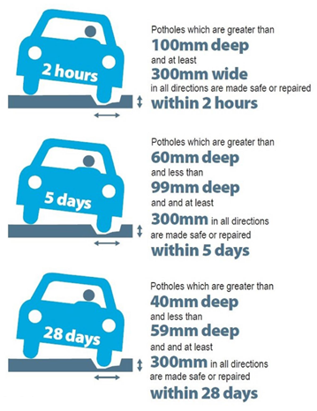
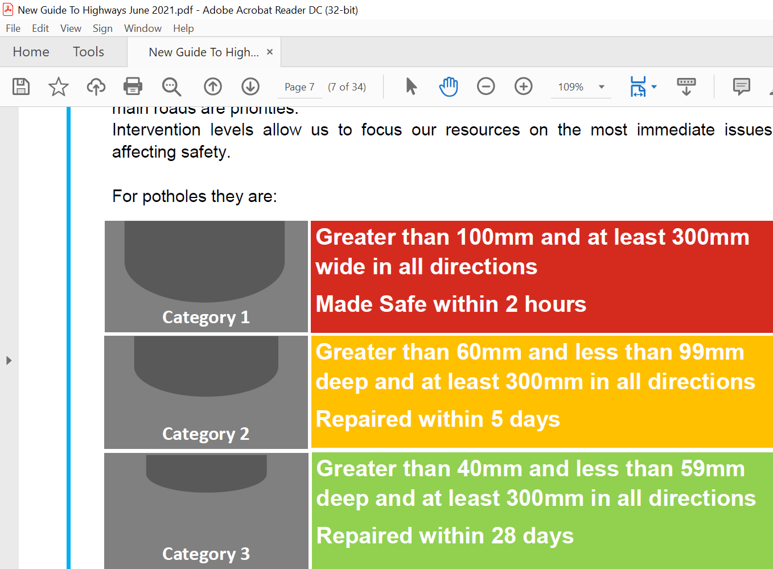
When do we repair a pothole?

Slide 10
Highways Policies & Services - Capital
Capital works are funded from one-off Capital Investment funder from Government grant and Council borrowing
This type of funding cannot be used for reactive works such as filling potholes, but can be used for replacement works such as resurfacing and patching.
These works are usually larger scale and deal with multiple issues at once and are delivered through an annual programme produced at the beginning of each year.
Resurfacing roads and footways, bridge repairs, street lighting column replacement, upgrades to traffic signals etc

Slide 11
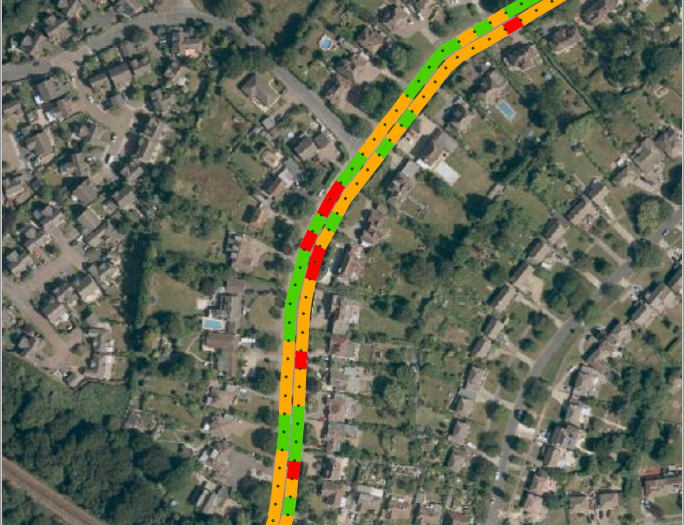
Annual Highway Condition Surveys
Highway condition surveys (red, amber, green condition) – including skid resistance and road grip
Defect reports from customers
Routine inspections by our Highway Stewards
We then produce prioritised lists of schemes

Slide 12
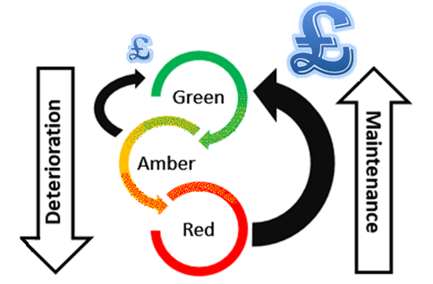
Asset Management Strategy
Our Asset Management Strategy sets out how the highway maintenance service is delivered against the Council’s key priorities, taking into account asset condition and resources available to ensure we make the best use of available resources.

Slide 13
Balfour Beatty Living Places
A new contract for all highway services commenced in May 2023 with Balfour Beatty Living Places (BBLP)
BBLP provide an end to end service on behalf of ESCC and manage all aspects of the highway maintenance services including, customer services, the repairs of safety issues on the network and managing the integrated delivery programme – delivering schemes across the County.
BBLP have a right first time ethos, it is our commitment that repairs will only need to be done once.
Quality Management
Increased levels of audits
Integrated systems enabling desktop reviews
SPIs

Slide 14
Life of a Pothole
Our ICT system “Confirm” allows the Community Steward to stipulate the size and type of repair alongside giving details of the requirements of traffic management, plotting the exact location and taking a series of photographs to give visibility of the defect to the schedulers and gangs for when they attend site.
All works raised become visible on dashboards allowing schedulers and the Operational Control Hub full visibility of target completion dates to ensure works are scheduled in time for completion.
Our team will schedule the works in the most efficient manner with works being grouped and plotted on a map, showing the proximity of each defect to each other.
When onsite, gangs have full visibility of all the details put forward by the Community Steward. Once the gang arrives they will take before and after photos of the defect.

Slide 15
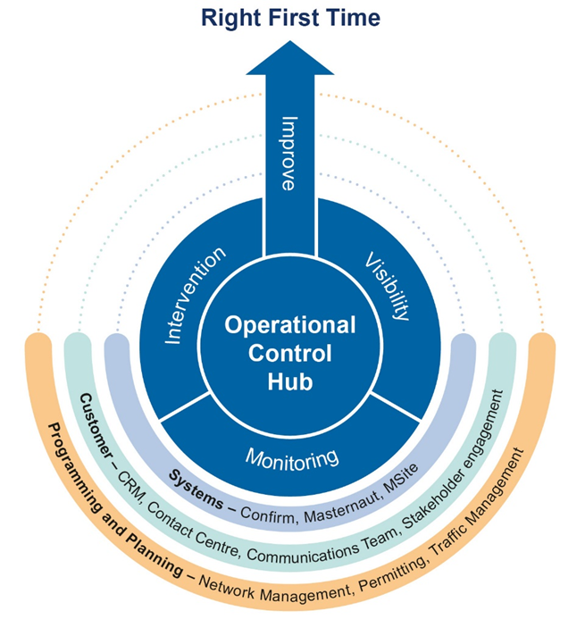
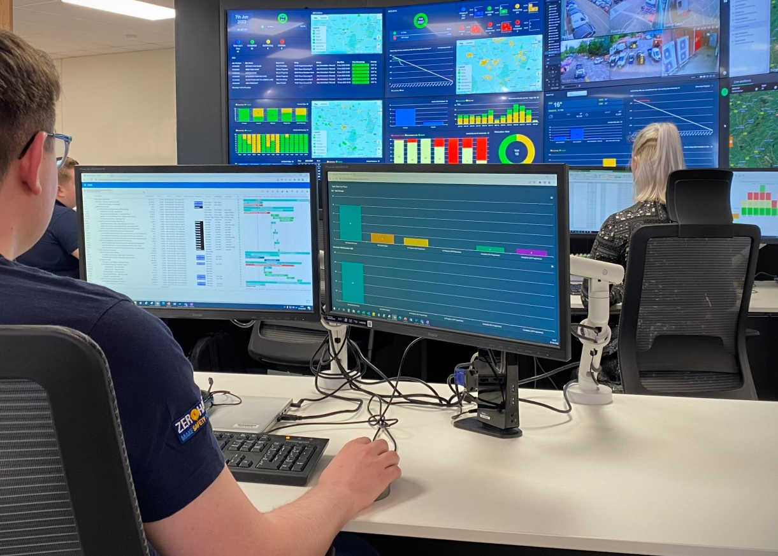
Our Operational Control Hub

Slide 16
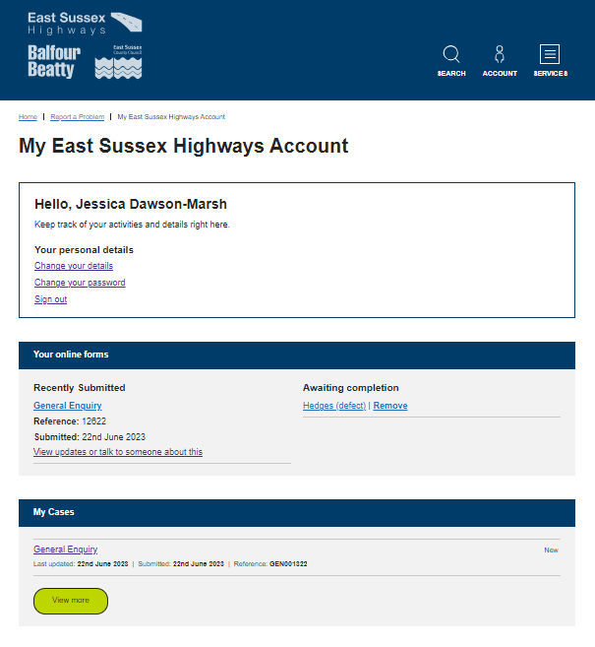
How to Report Issues
District and Borough Councillors are welcome to create online customer accounts at www.eastsussexhighways.com
You will receive automated updates as your cases progresses, with a final response as to whether any works will be carried out or not
You can monitor and manage your open and closed cases
You are also able to view our work programmes online and find a wealth of information about the different services we provide
Guide to Highways https://live.eastsussexhighways.com/downloads/file/9/guide-to-highways

Slide 17
Thank You & Any Questions?

