Slide 1
Climate and Ecological Emergency
Dr Lucie Bolton
Environment Strategy Officer, Rother District Council

Slide 2
Contents
Introduction
District Emissions
Role of Local Authorities
RDC Climate Action
Town and Parish Council Climate Action
RDC Support

Slide 3
Rother District Emissions
Rother District 2020: 479.9 ktCO2e (100%)
RDC 22/23: 118 tCO2e (0.02%)

Slide 4
Rother District Emissions

Slide 5
The Role of Local Authorities

Slide 6
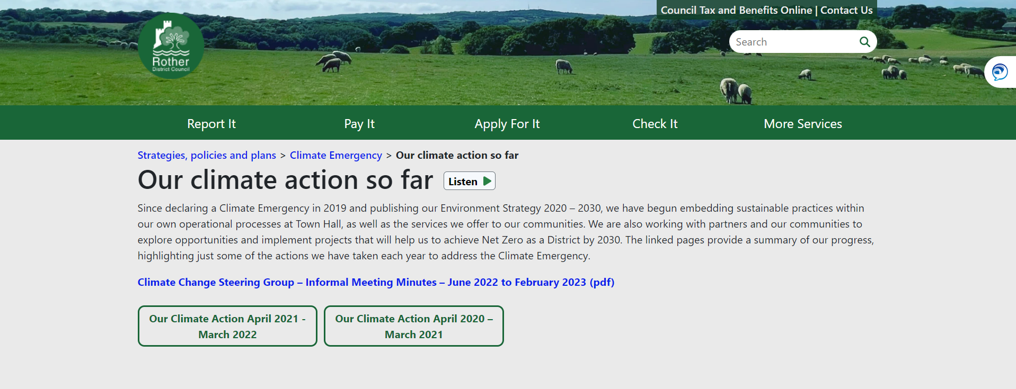
RDC Climate Emergency Declaration - 2019
‘Pledge to do what is within our powers, to make Rother District carbon neutral by 2030, taking into account both production and consumption emissions’
Environment Strategy (2020)

Slide 7
Climate Strategy
BUILDINGS AND
ENERGY EFFICIENCY
BIODIVERSITY AND
LAND USE
TRANSPORT
ENERGY GENERATION
RESOURCE CONSUMPTION
AND WASTE

Slide 8
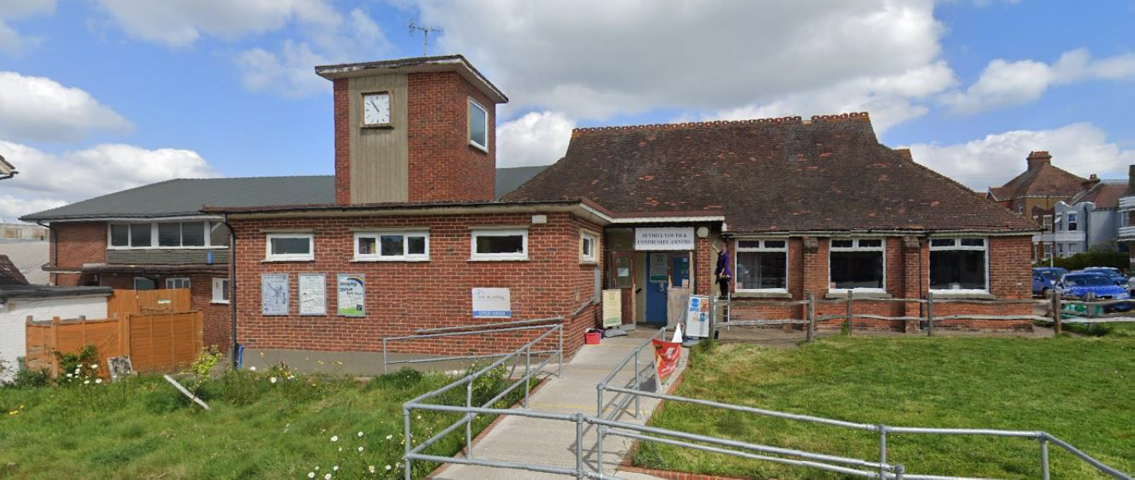
Buildings and Energy Efficiency
Council’s direct emissions
Operational buildings
Town Hall
Temporary Accommodation
District emissions
Leased buildings
Funding for low-income households
Working with SMEs
Parish and Town Councils
Energy Champions
Village Halls Energy Project

Slide 9
Town and Parish Council Climate Action
8 of 33 Parish and Town Councils in Rother have made declarations
Battle
Bexhill
Brightling
Crowhurst
Ewhurst
Hurst Green
Sedlescombe
Salehurst and Robertsbridge
Establish a sub-committee
Carbon baselining/ reporting
Climate Action Plan
Reducing emissions

Slide 10
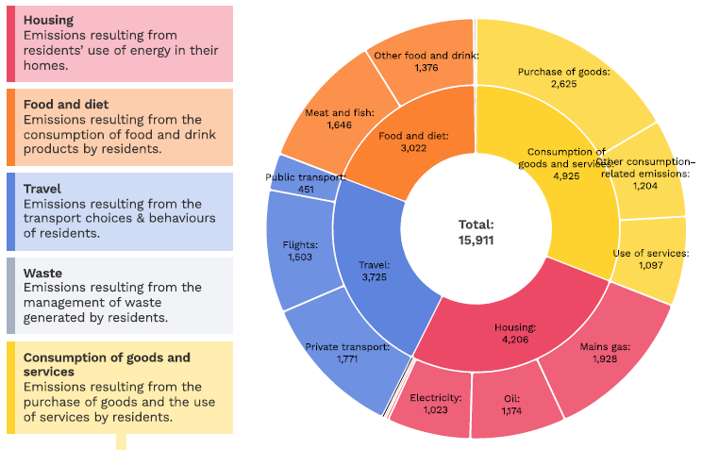
Brede’s Carbon Footprint - Consumption

Slide 11
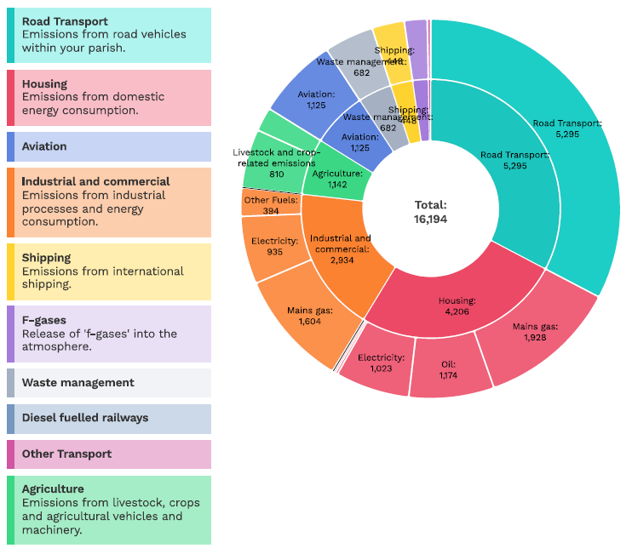
Brede’s Carbon Footprint - Territorial

Slide 12
Town and Parish Council Climate Action
Climate Action examples
Develop and promote green transport plans, including safe routes to school, car clubs, EV charging points, cycling etc
Home energy efficiency education
Community food growing schemes
Community composting
Repair hubs and library of things
Reusable nappy library
Food waste reduction
Climate education
Parish litter reduction
Plastic and packaging reduction
Manage green spaces for wildlife

Slide 13
RDC Support
Corporate Plan – Climate Emergency
Incentivise Parish and Town Councils to declare Climate Emergencies
Staff support – PC’s Organisational Carbon Footprint using the LGA tool
Funding – RDC funding and external
Carbon Literacy Training – Parish, Town and Community Council Toolkit
Rother Climate Action – Forum

